Slide 1
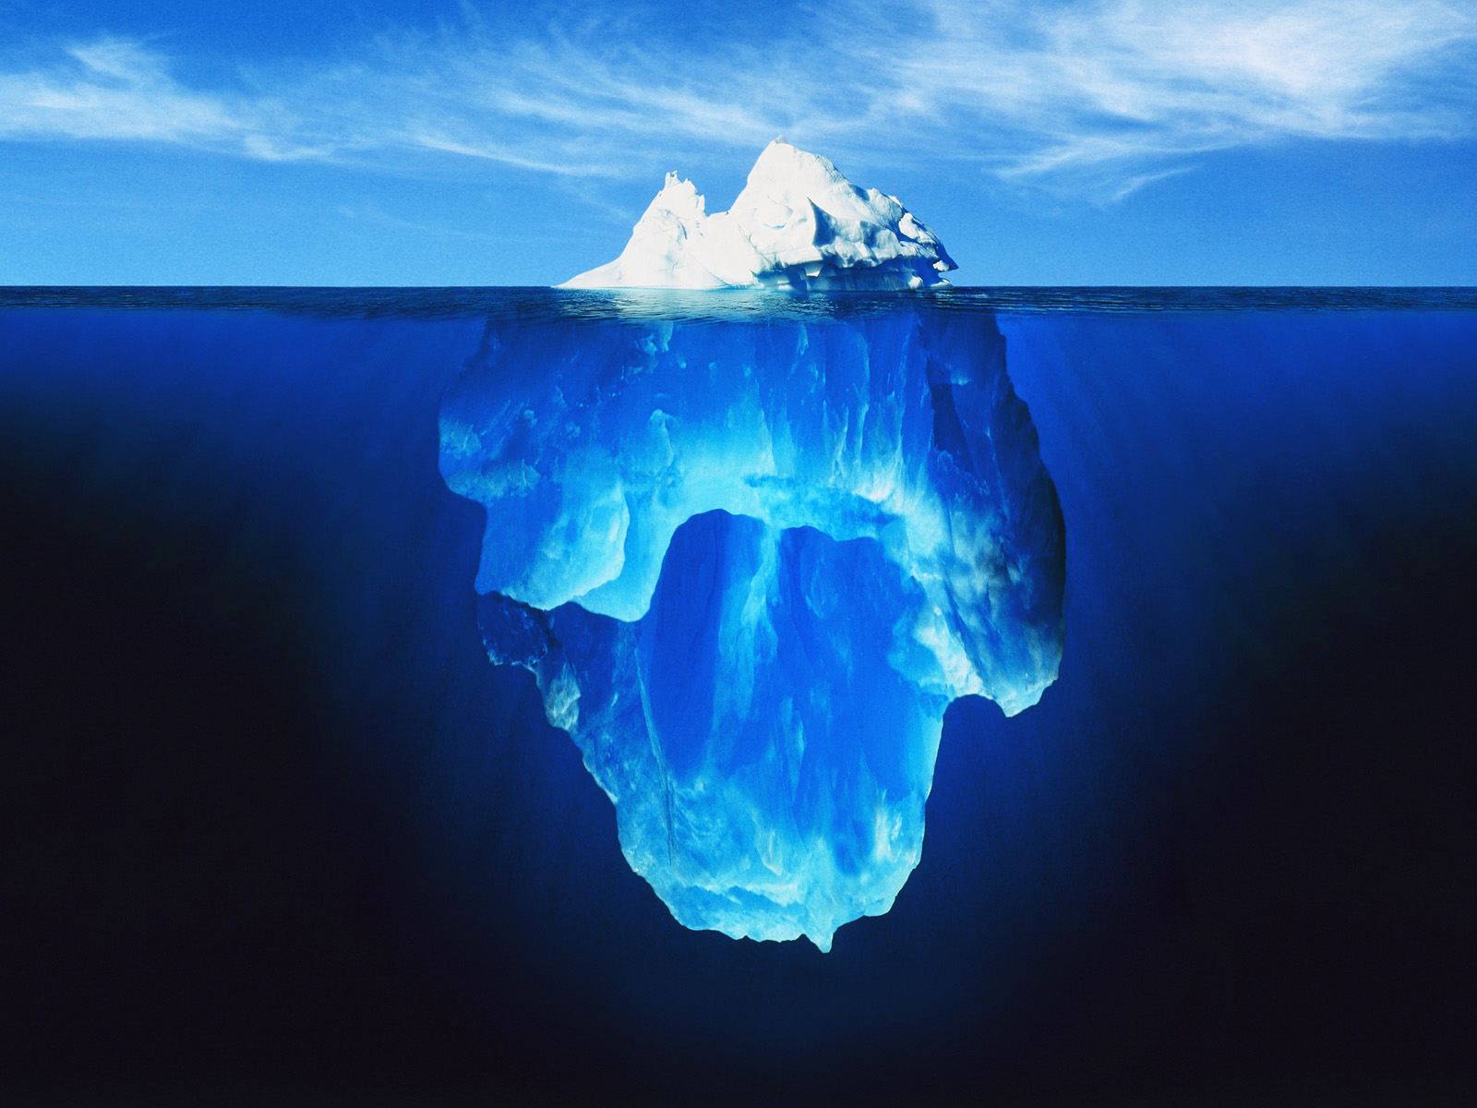
New Ways of Teaching
From naïve to smart use of technology
Michael E. Caspersen
Department of Computer Science
and Centre for Science Education

Slide 2
Agenda
CSE and Frontiers in Science Education
  2012: Clickers, Peer Instruction, and the Inverted Classroom
  2014: Transforming Education with Technology
  A few derived initiatives @ ST
The Times They Are A-Changin’
  Traditional teaching
  From naïve to smart use of technology
  STREAM: Flipped classroom, active learning, just-in-time teaching, ...
Miscellaneous
  MOOCs
  Misuse of Technology in Class

Slide 3
Agenda
CSE and Frontiers in Science Education
  2012: Clickers, Peer Instruction, and the Inverted Classroom
  2014: Transforming Education with Technology
  A few derived initiatives @ ST
The Times They Are A-Changin’
  Traditional teaching
  From naïve to smart use of technology
  STREAM: Flipped classroom, active learning, just-in-time teaching, ...
Miscellaneous
  MOOCs
  Misuse of Technology in Class

Slide 4
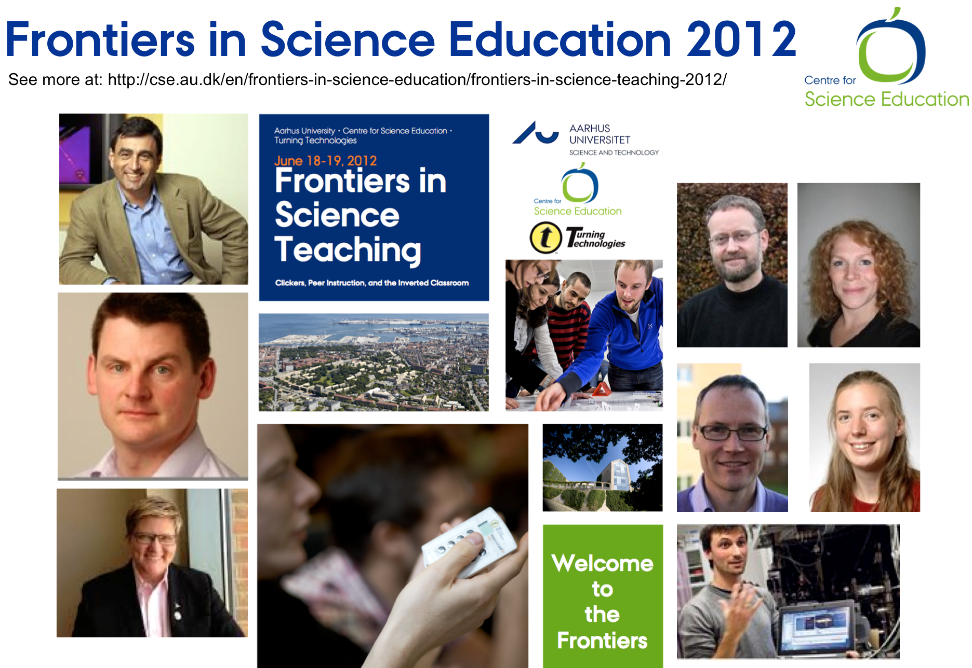
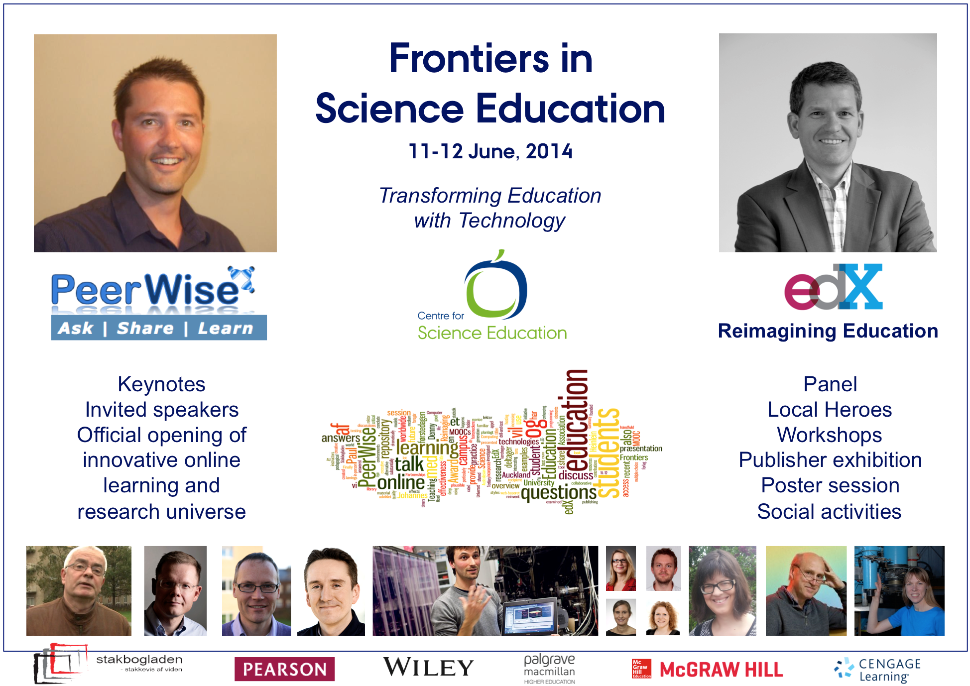
Frontiers in Science Education
2012, 2014, ...
Renowned experts
- internal and external
- shifting the balance over time

Slide 5

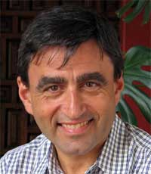
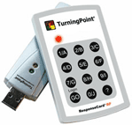
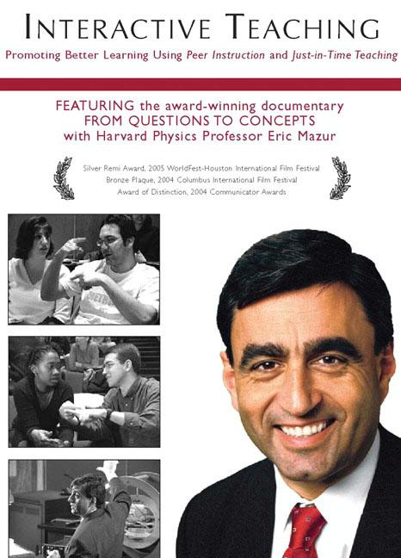
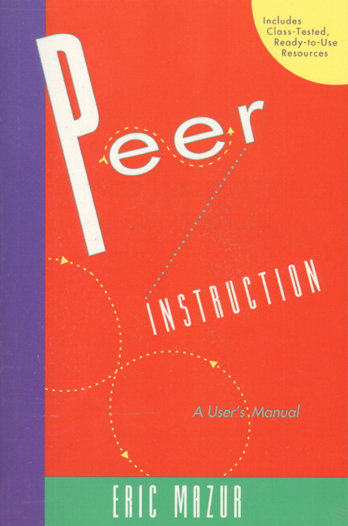
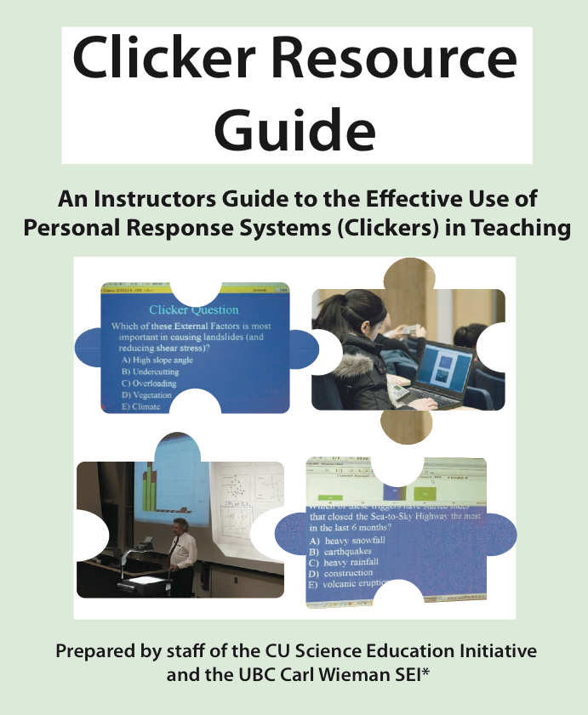
Peer Instruction and Clickers
Why?
A simple and appealing technology
Relatively easy to adopt at scale
Research-based evidence
Learning-oriented
Eric Mazur, Harvard University
"Confessions of a converted lecturer"
Great support material

Slide 6
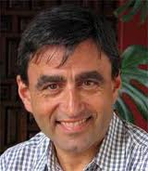
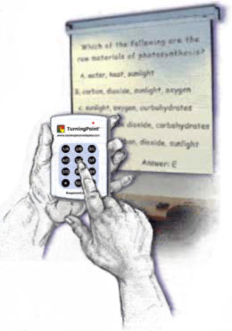

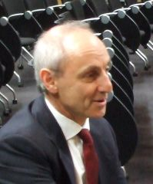
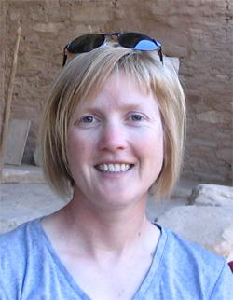
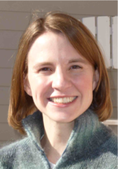
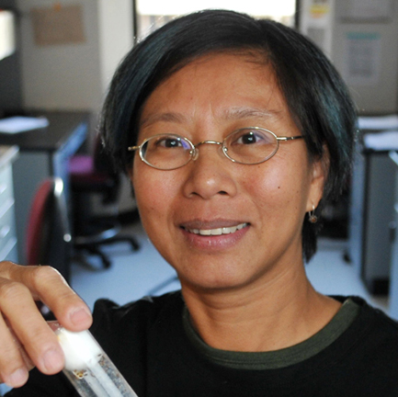
Peer Instruction and Clickers
Dissemination @ AU-ST
(number of teachers)
100+
Eric Mazur
Harvard University
Inaugural lecture
- official opening of CSE
83
Peter Dourmashkin
MIT
Workshop
>48
Beth Simon
UC San Diego
Invited talk
Three workshops
50
40
Michelle K. Smith
UC Boulder
1-1 Facilitation
Invited talk
Two workshops
10
2
Time
Tin Tin SU
UC Boulder
Invited talk
2009-10
2010-11
2011-12
2012-13
2013-14
*
*
*
*
*
*
*
*
*
*
*
*
*

Slide 7
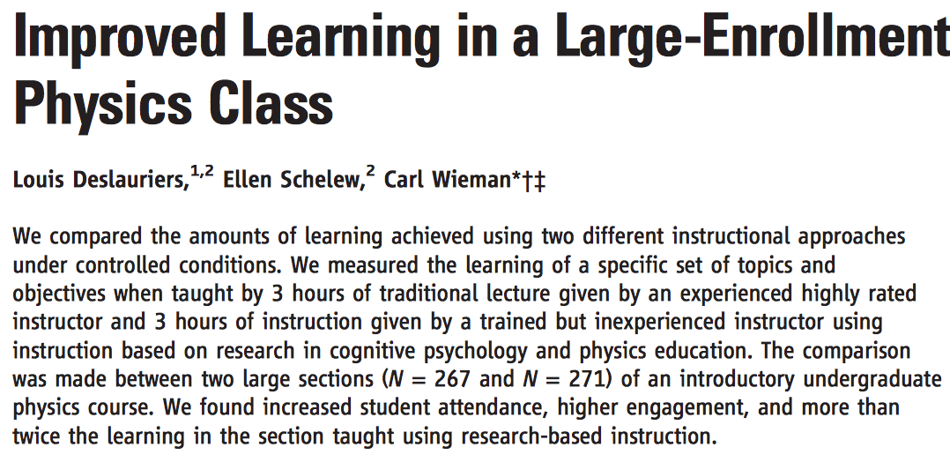
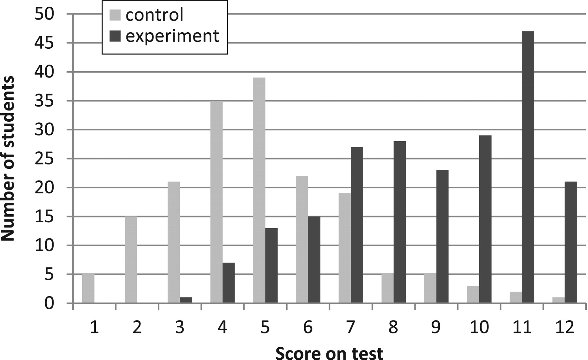
Effect of Active Learning
Controlled study, published in Science (2011), 332:862
Score on test in introductory physics course
expert traditional lecturer vs. post-docs using peer instruction+ (n = 171+211 students)

Slide 8
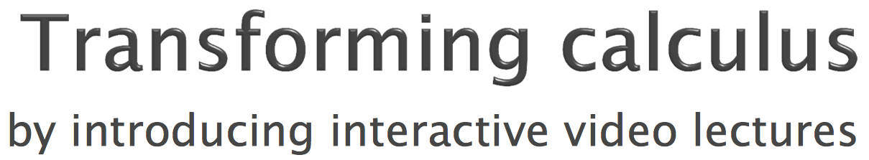


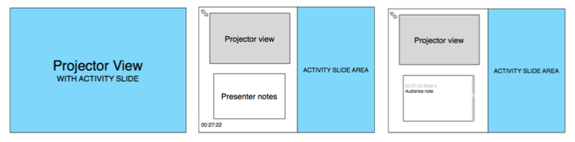
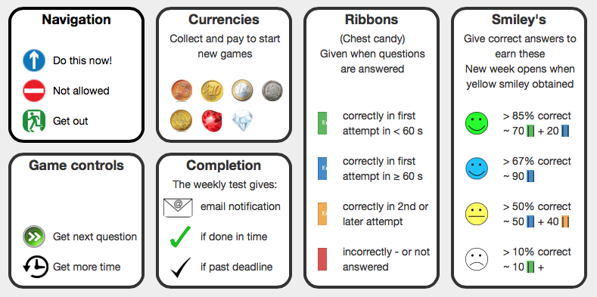
A Few Derived Initiatives @ ST
Remarkable Edu IT development @ ST
Redesigned Calculus I & II
  Klaus Thomsen, MATH
  Our very first clicker user in fall 2009
curriculearn.dk
  Ditlev Brodersen, MBG
  Early adoption of clickers, PI, ...
  Frontiers 2012 and 2014 → PeerWise
  → curriculearn.dk
InPlenary
  Clemens Nylandsted Klokmose, CS
  Initiated at DiLD (adjunktpædagogikum)
sci2u.dk
  Bjørk Hammer, PHYS
  Frontiers 2012 and 2014
  → PeerWise (and Paul Denny)
  → sci2you (tool and framework)

Slide 9
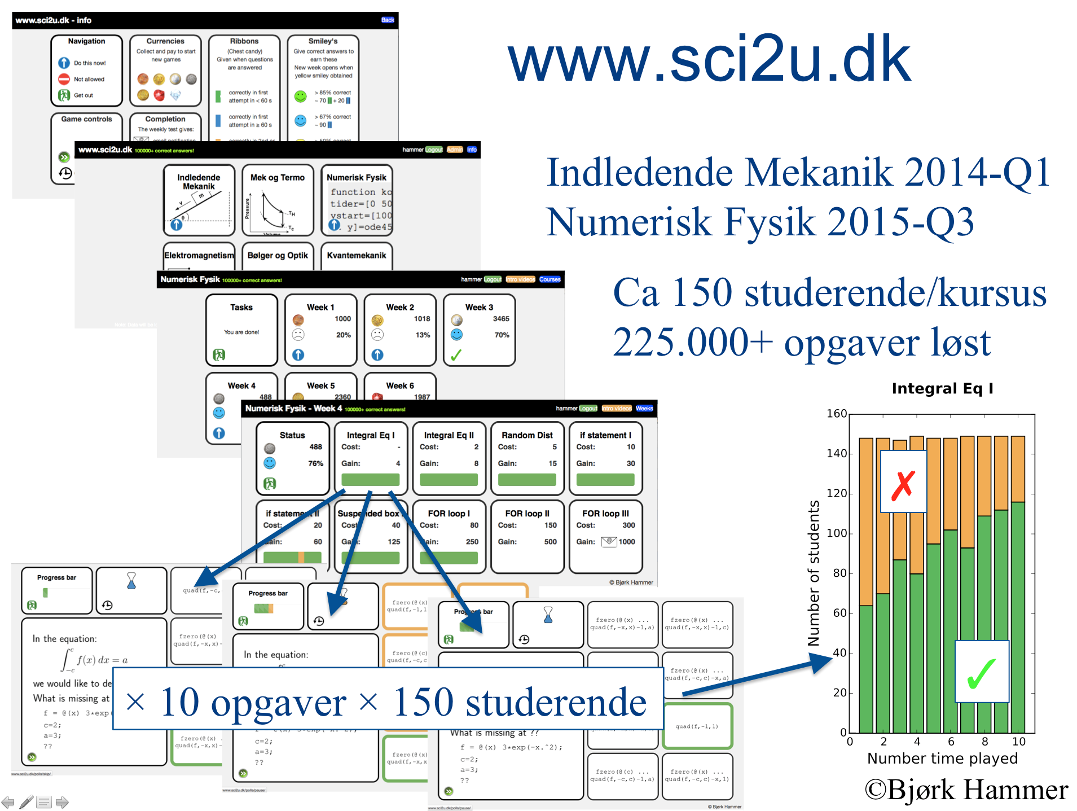
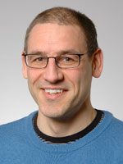
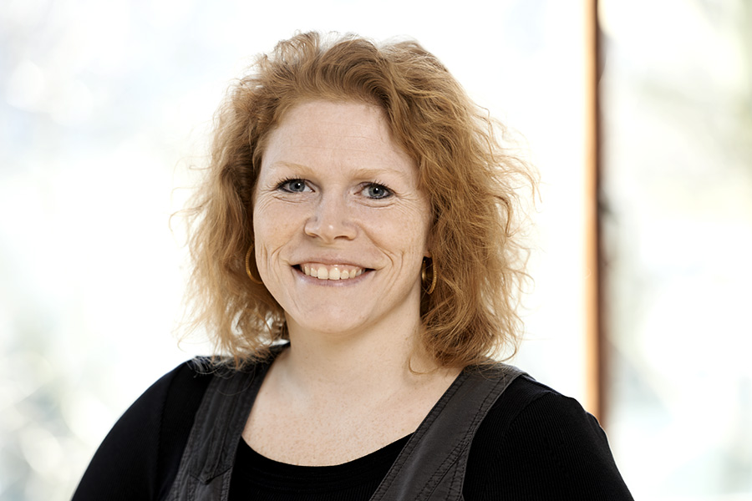
Science to you
Bjørk Hammer, IFA
Professor
EliteForsk-pris 2009
Scientific teaching (learning analytics)
Aiming for joint publication with
Pernille Maj Svendsen from CSE

Slide 10
Agenda
CSE and Frontiers in Science Education
  2012: Clickers, Peer Instruction, and the Inverted Classroom
  2014: Transforming Education with Technology
  A few derived initiatives @ ST
The Times They Are A-Changin’
  Traditional teaching
  From naïve to smart use of technology
  STREAM: Flipped classroom, active learning, just-in-time teaching, ...
Miscellaneous
  MOOCs
  Misuse of Technology in Class

Slide 11

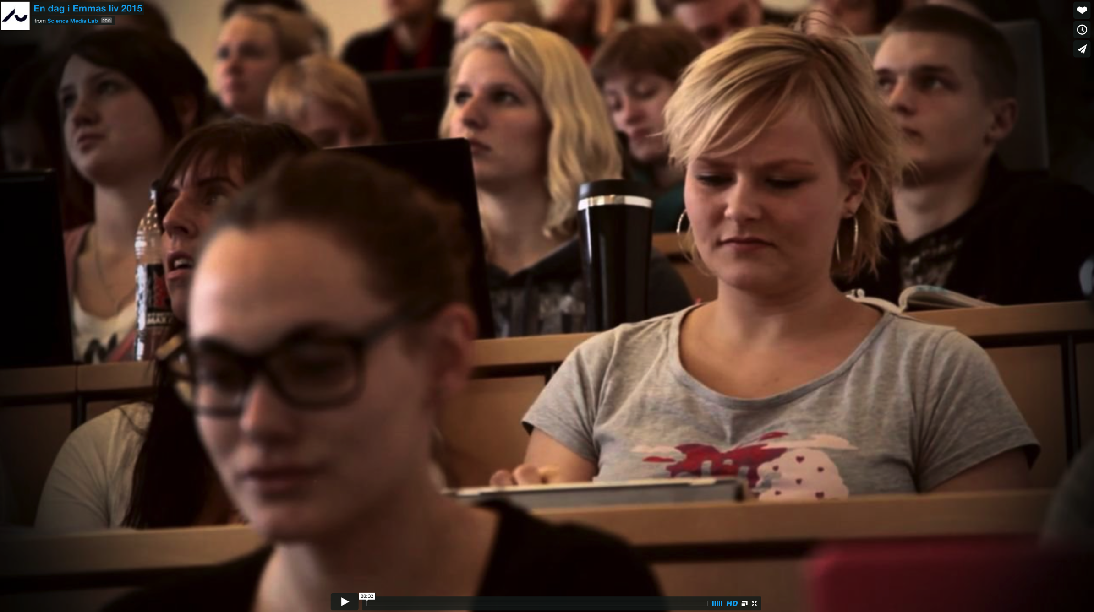
The Times They Are A-Changin’
Challenges and opportunities
Turbulence (recent “ledelsesseminar”)
  Political awareness
    fremdrift, akkreditering, dimensionering, reformering, ...
  Quality (effectiveness)
  Resources (efficiency)
  Global competition
Technology
  A game changer in academia
  Particularly in education
  Loads of affordances
  A new mindset
  A day in the life of Emma (Victor)

Slide 12
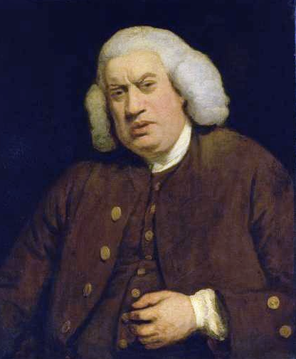
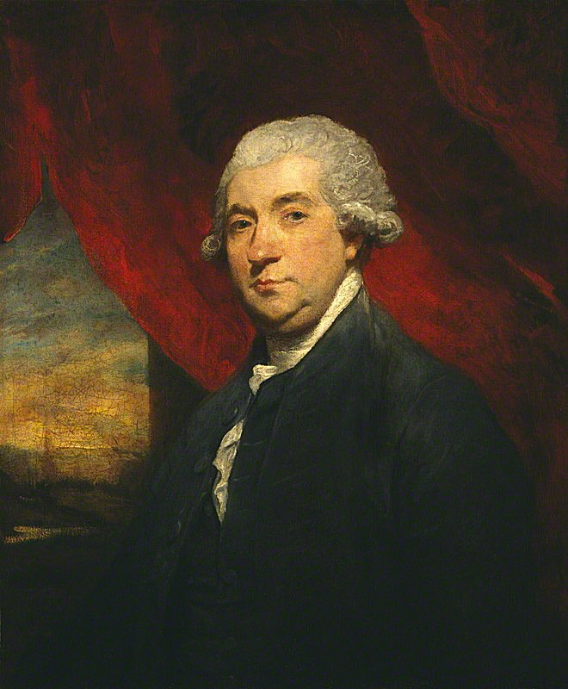
New Technology as Game Changer
15th April, 1781 (Easter Day):
“We talked of the difference between the mode of education at Oxford and that in those colleges where instruction is chiefly conveyed by lectures.
Lectures were once useful; but now, when all can use this new and widespread technology, lectures are unnecessary.
If your attention fails, and you miss a part of the lecture, it is lost; you cannot go back as you can with the new technology.”
read, and
books are so numerous
Samuel Johnson
(1709-1784)
do upon a book
The Life of Samuel Johnson, by James Boswell, 1791
No reason to believe that naïve use of technology will have a profound impact on education.
We need to embrace technology more thoroughly...
James Boswell
(1740-1795)

Slide 13
The Traditional Approach
Emphasis on dissemination
The two steps of education
1. Dissemination
  The first step is information transfer
2. Assimilation
  The second – much more important step – is for the learner to make sense of that information. To do something with that information. To extract from that information the mental models, the knowledge, and the skills that will make the learners successful in their future career.
Traditional approach
  Puts all of the emphasis on the first step leaving the much harder second step to our students on their own (or with the youngest and most inexperienced teachers, the TAs)

Slide 14
Naïve Use of Technology
New Ways of Dissemination
Technology
1. Dissemination
2. Assimilation
Naïve modernization
  Moving the first step from the lecture hall to videos/online material (the computer screen)
  This alone is unlikely to have a profound impact

Slide 15
Smart Use of Technology
New Ways of Assimilation
1. Dissemination
2. Assimilation
Smart modernization
  Use technology to also facilitate assimilation of information
  Automate (or semi-automate) routine aspects of education
  Accommodate diversity
  Save face-to-face time for more challenging and interesting aspects of education
  More effective for students; more fun for teachers
Technology

Slide 16
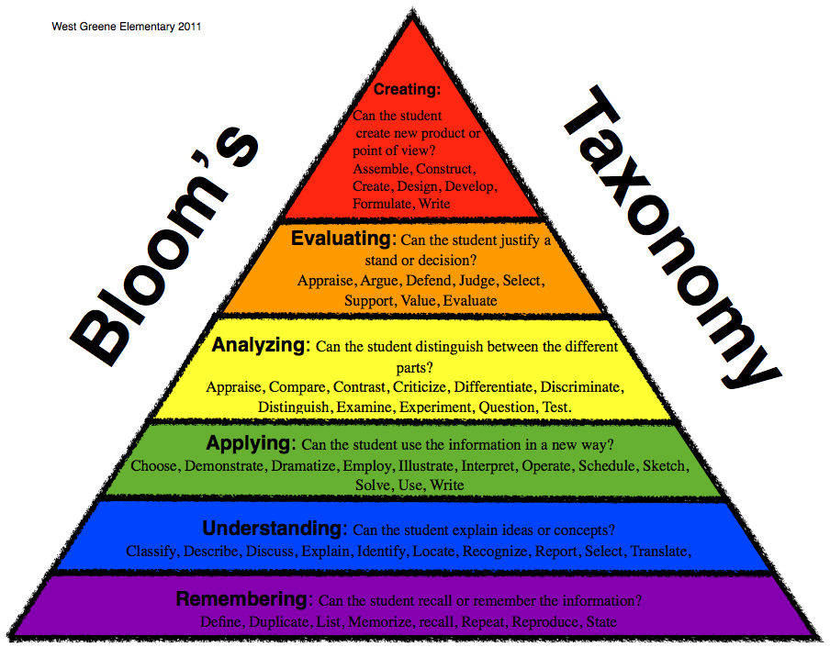
The essence of ”flipped classroom”
Two ways to invert your classroom (Simon Bates keynote, Frontiers 2012)
http://cse.au.dk/en/frontiers-in-science-education/frontiers-in-science-teaching-2012/videos/
Use technology for
- dissemination
- basic assimilation
Save face-to-face time for
more advanced assimilation
(what can’t be “automated”).
Maximize f2f time spent here
...instead of wasting f2f time here
Resource
http://cft.vanderbilt.edu/guides-sub-pages/flipping-the-classroom/
http://cse.au.dk/en/frontiers-in-science-education/frontiers-in-science-teaching-2012/videos/

Slide 17
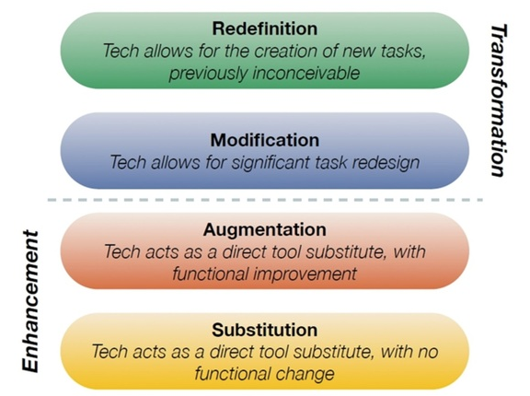
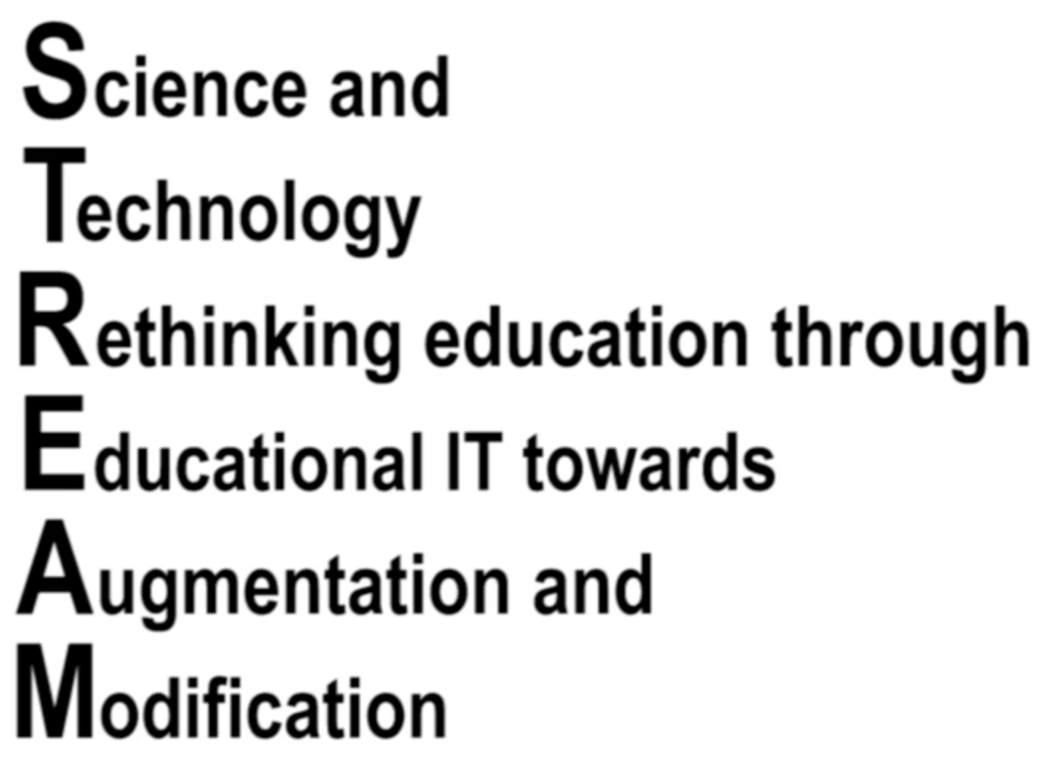
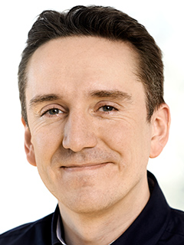
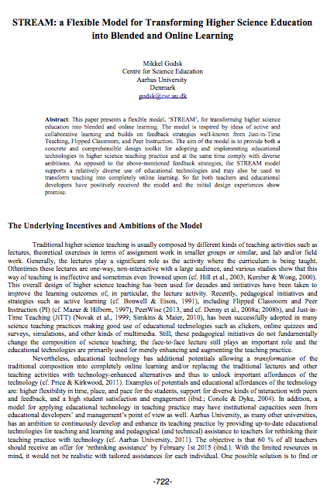
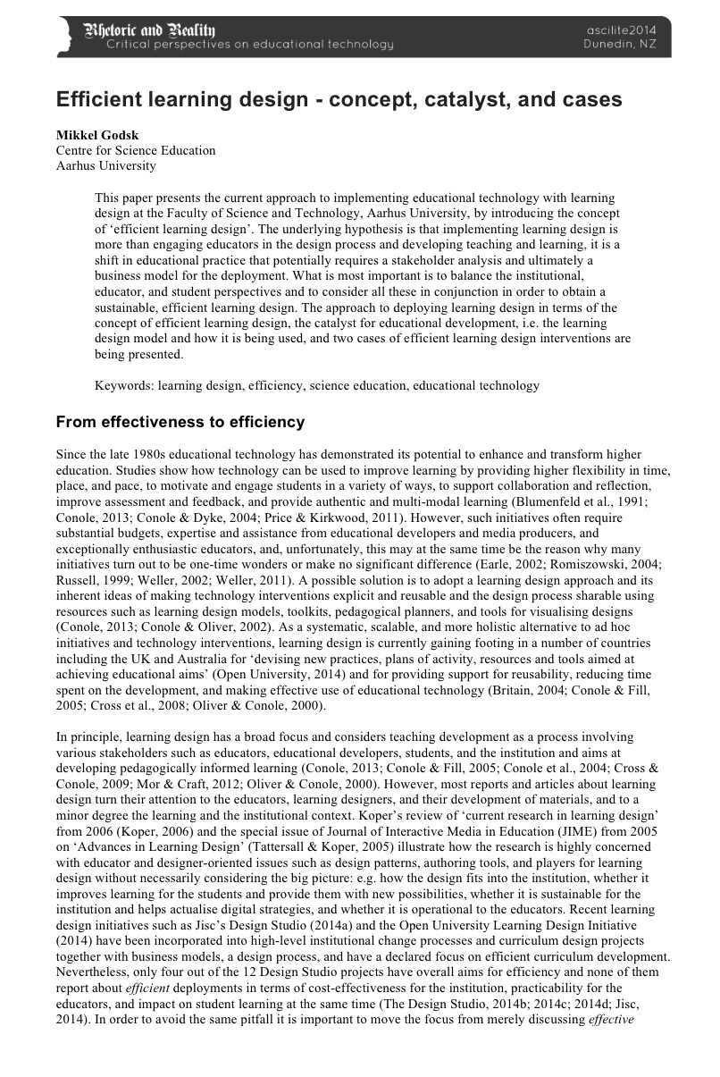
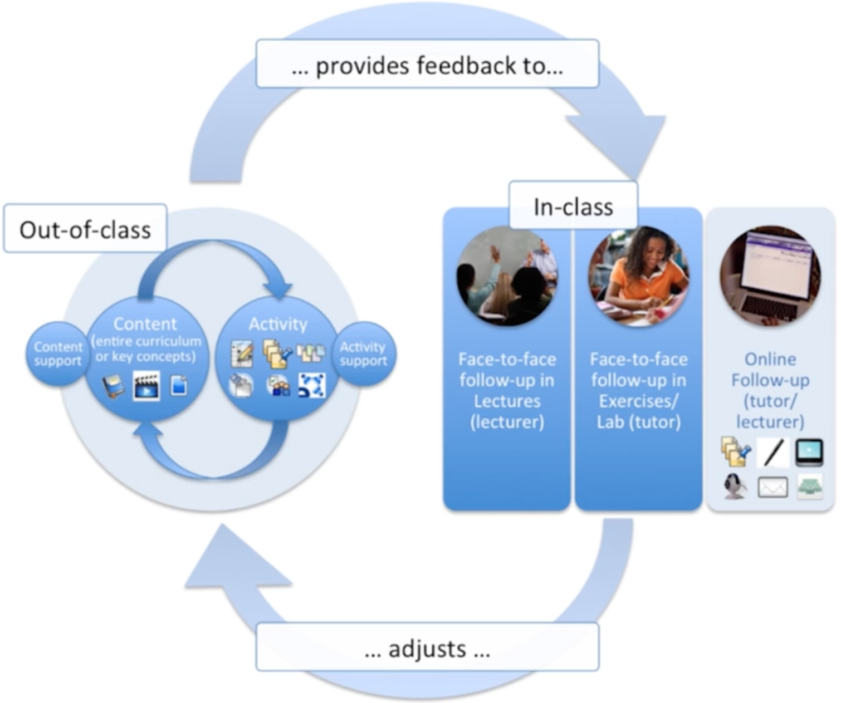
Models and Methods for Edu IT
SAMR and STREAM
R
M
A
S
STREAM: A Learning Design (framework)
[ SAMR: https://www.youtube.com/watch?v=_QOsz4AaZ2k ]
[ STREAM: http://cse.au.dk/forskning/projekter/stream/ ]
Mikkel Godsk
STLF @ CSE
Digital Learning Design

Slide 18
STREAMed Courses @ ST
More info: [ http://cse.au.dk/forskning/projekter/stream/ ]
SAMR-annotation
R
M
A
S
R: ‘ASE Adgangskursus’ (E15)
R: Digital Learning Design (E13)
R: Electronic Engineering (full degree, E15)
M: Calculus I (E14)
M: Calculus II (E13+E14)
M: Microbial Physiology and Identification (F14)
A: Astrophysics
A: Evolution and Diversity (F14)
A: Introduction to programming (E13)
A: Microbiology (F14)
A: Master in Animal Welfare (F14)
A: Tropical Ecosystem Management and Human Security (E13)

Slide 19
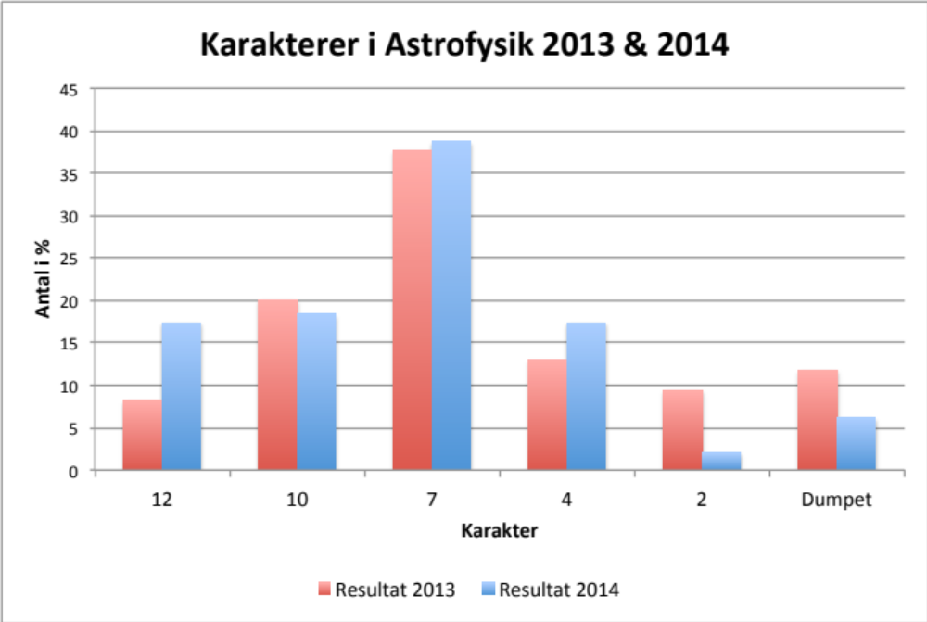
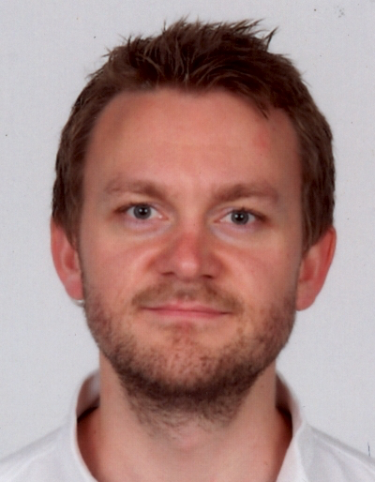
Astro Physics
Results from a redesigned first year course (Q2)
Ole Eggers Bjælde, CSE
STLF
Lecturer (gradual withdrawal from the course)
Elements of redesign
- flipped classroom á la
STREAM
- active learning in lectures
- formative feedback
- incremental grading
Student evaluation
- Jeg synes online-aktiviteterne har hjulpet rigtig meget til forståelsen af pensum. Forelæsningerne har været gode men læringsudbyttet har helt sikkert hos mig været størst i onlineaktiviteterne. Jeg synes onlineaktiviteterne er en god måde at at få alle med på, men det tager til gengæld også meget tid, når der til hver uge også skulle læses 2-3 kapitler.
Det mindsker ikke forberedelsestiden, men man lærer mere. Studerende på fysik.

Slide 20
Agenda
CSE and Frontiers in Science Education
  2012: Clickers, Peer Instruction, and the Inverted Classroom
  2014: Transforming Education with Technology
  A few derived initiatives @ ST
The Times They Are A-Changin’
  Traditional teaching
  From naïve to smart use of technology
  STREAM: Flipped classroom, active learning, just-in-time teaching, ...
Miscellaneous
  MOOCs
  Misuse of Technology in Class

Slide 21
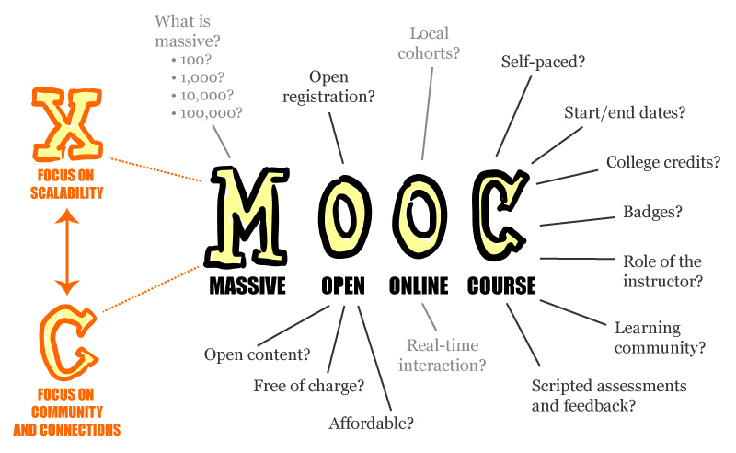
MOOCs
Massive Open Online Course
Several players
  Coursera (Andrew Ng and Daphne Koller, Stanford spin-off)
  Udacity (Sebastian Thron, Google/Stanford)
  edX (MIT, Harvard, ...)
  FutureLearn (UK)
  iversity (GER)
  OpenupEd (EU)
  France Université Numérique (F)
  Open2Study (AUS)
  Veduca (BRA)
  ...
Related resources
  Khan Academy
  Peer to Peer University
  Course Hero
  Udemy (T)
  ...

Slide 22
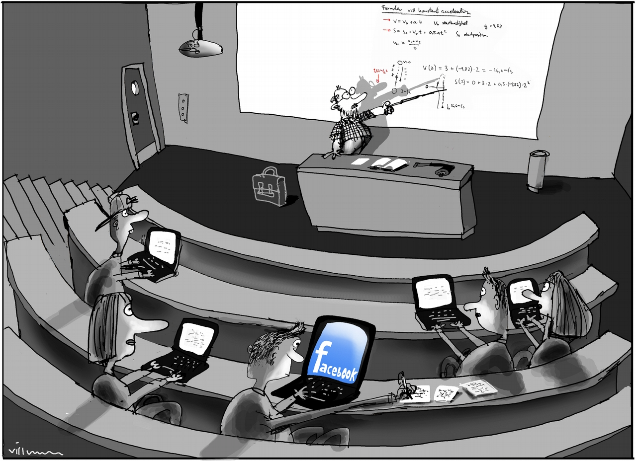
Misuse of Technology in Class
”Studerende hygger sig med netspil og Facebook under forelæsninger”
Politiken, 4. januar 2015
Extensive misuse
  59% misuse technology
  94% of these lose focus
Passive misuse
  58% annoyed by fellow students’ misuse
Ban or embrace
  Go to the back or leave...
  Awareness
  Activate, involve, ...

Slide 23
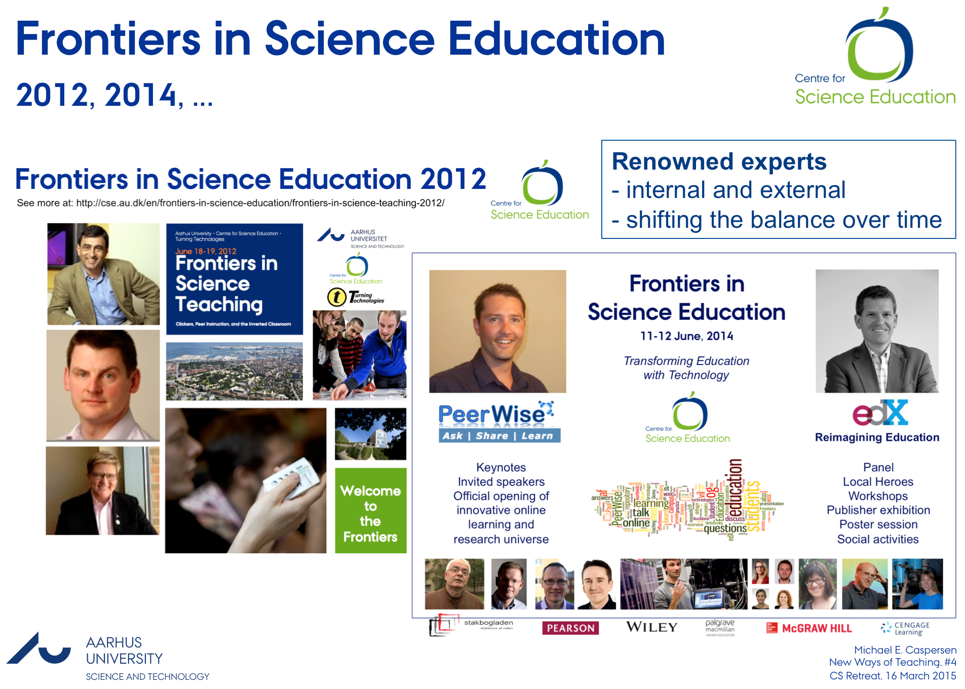
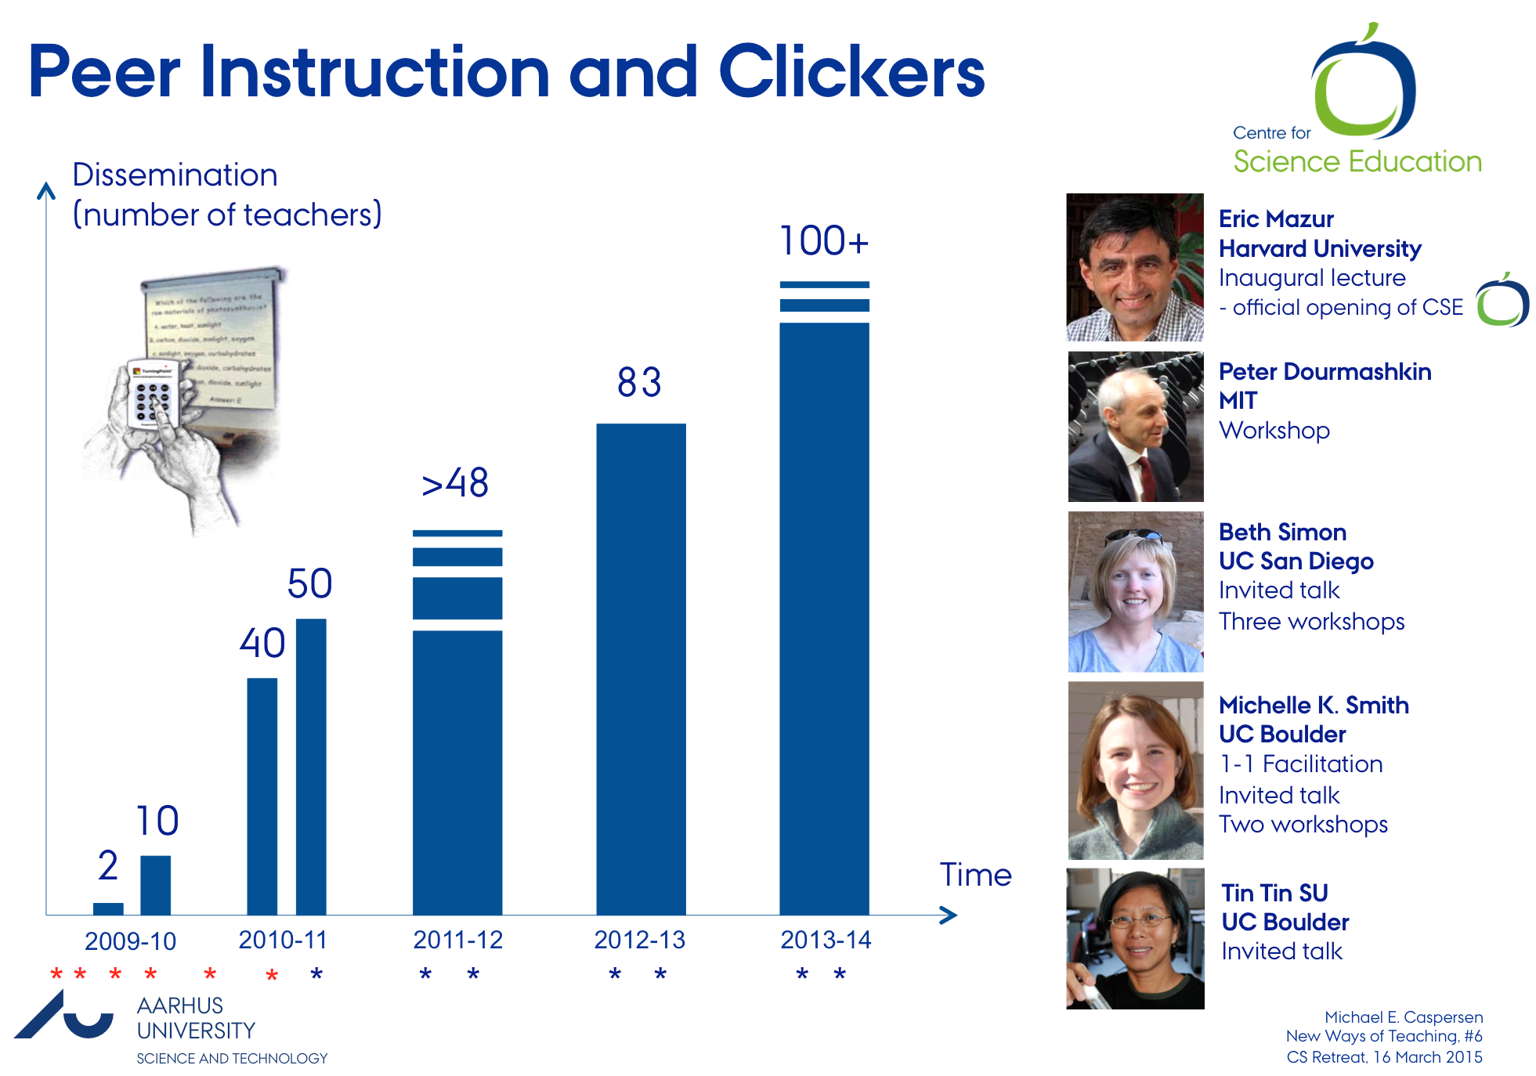
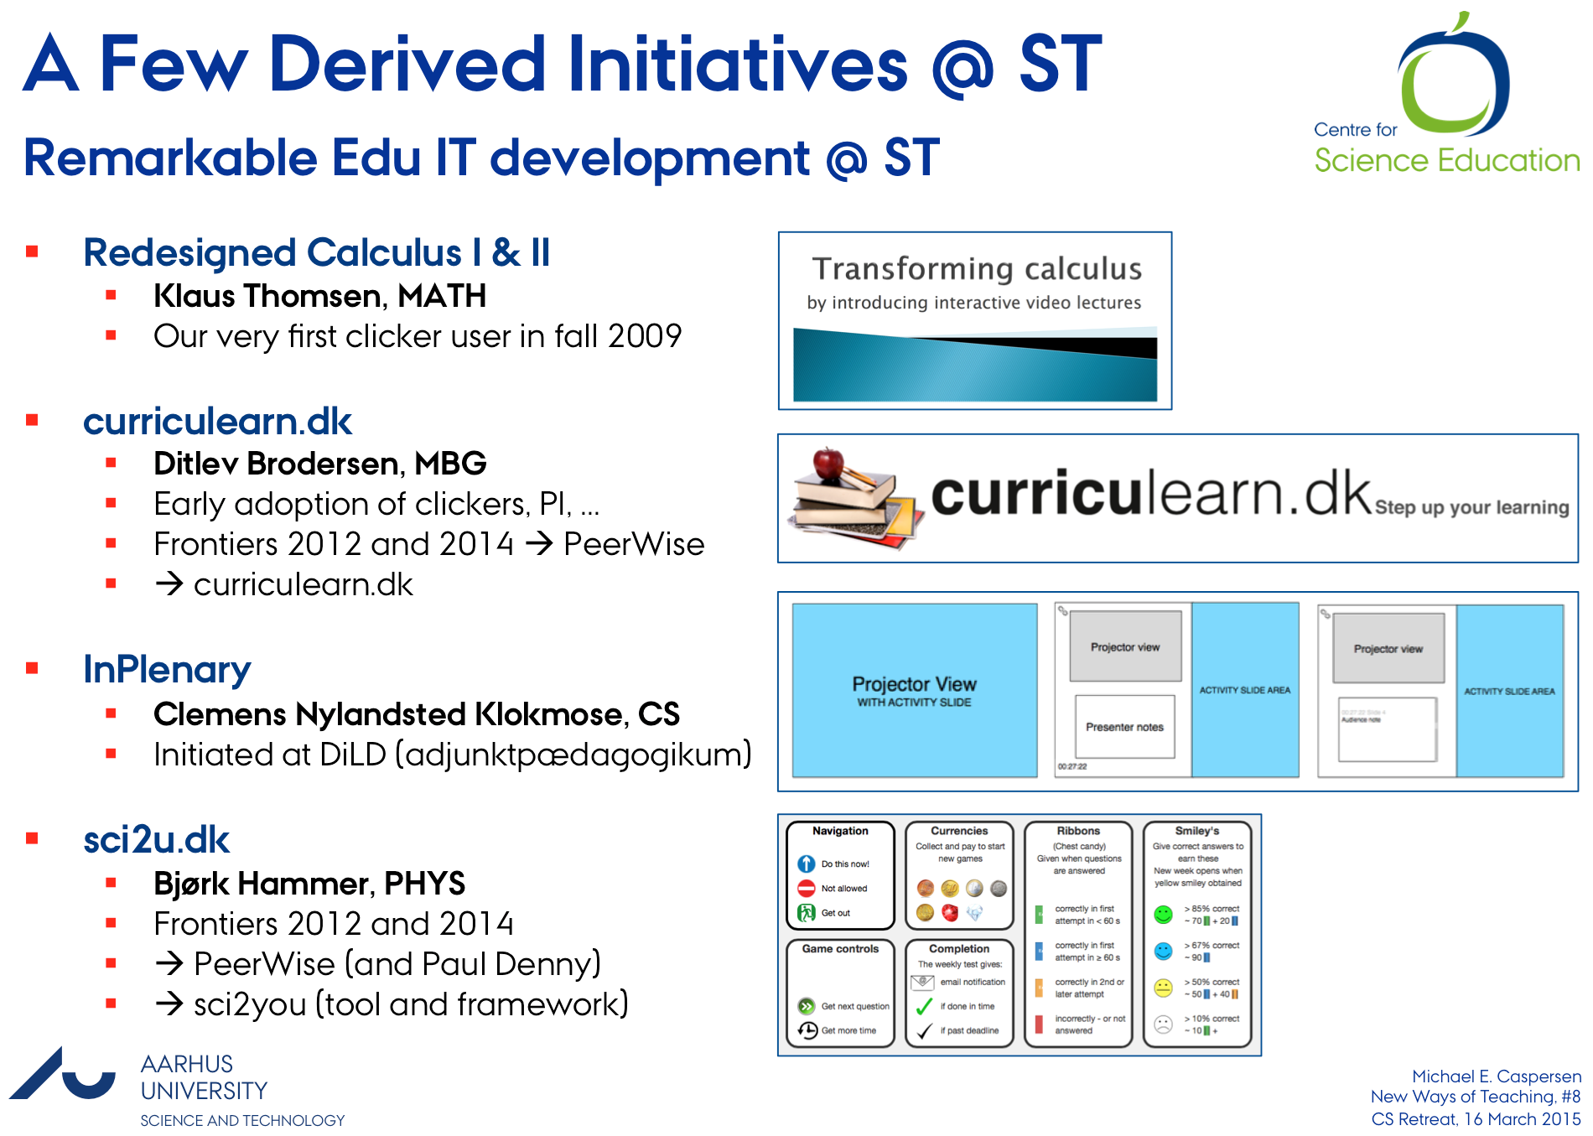
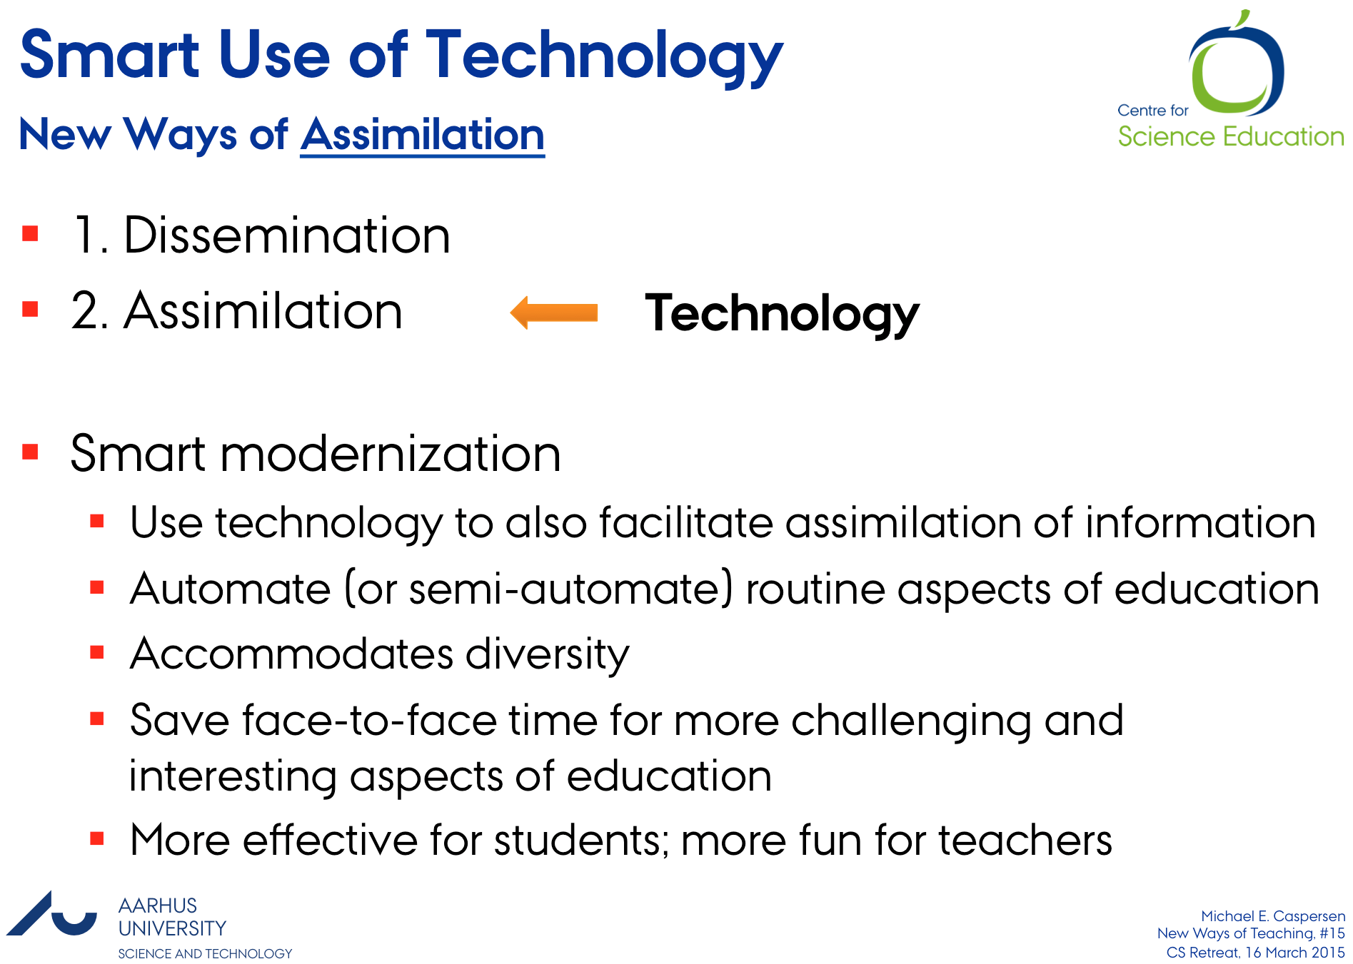
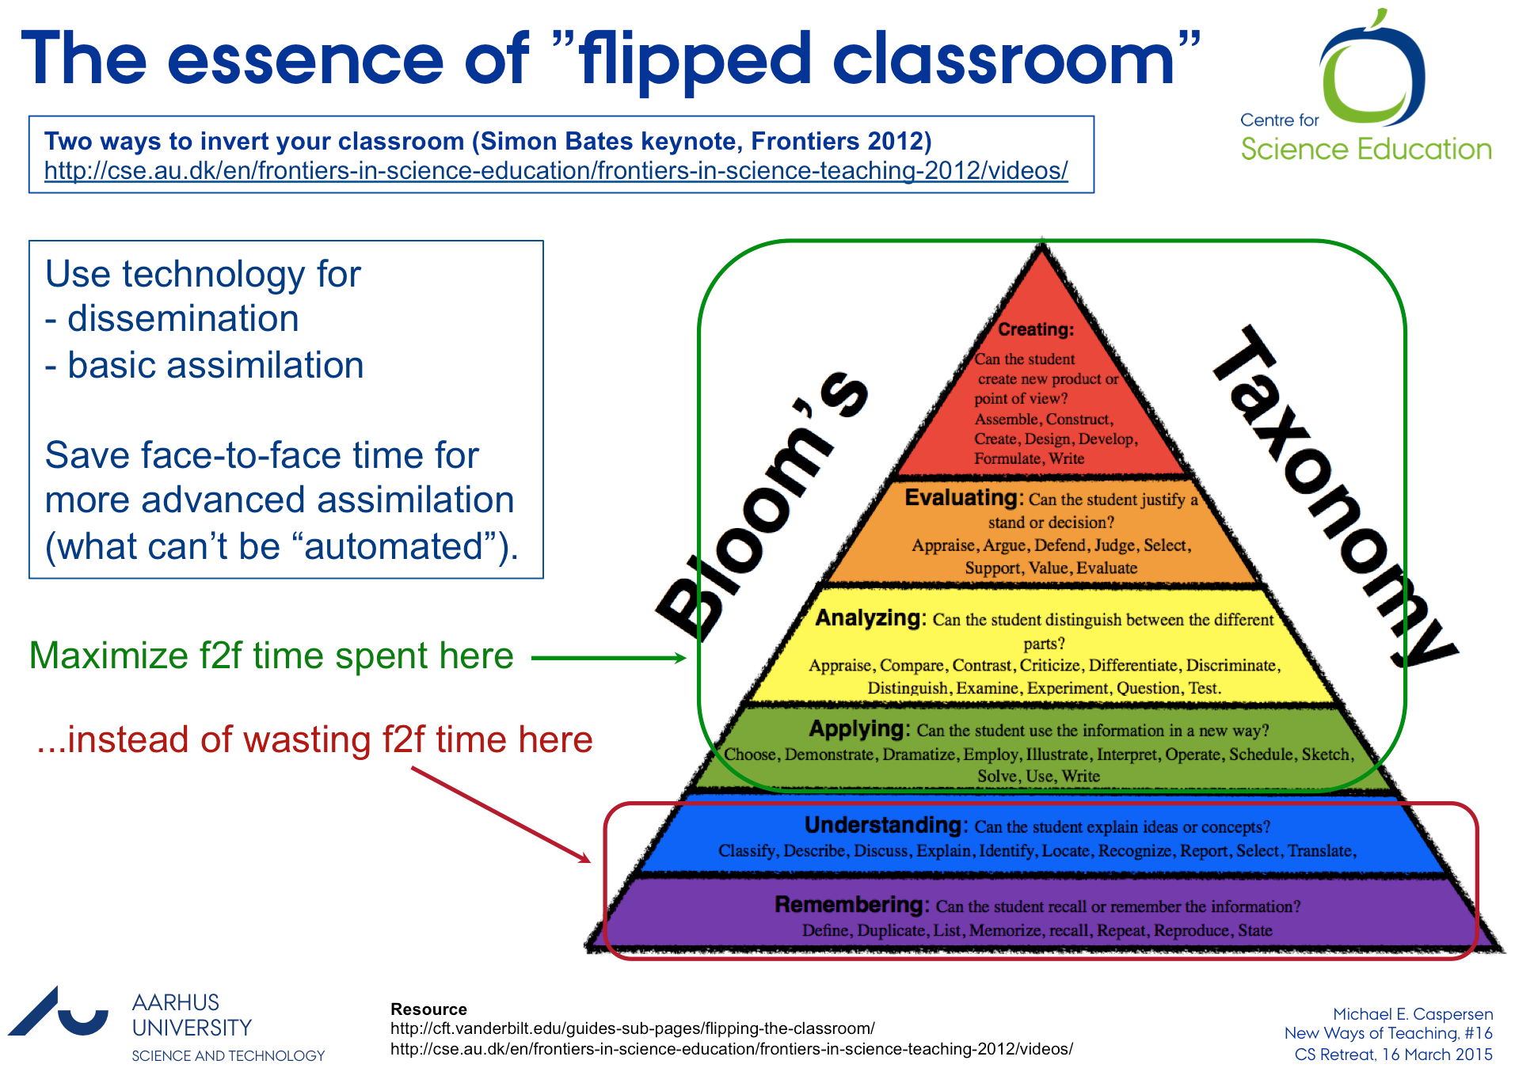
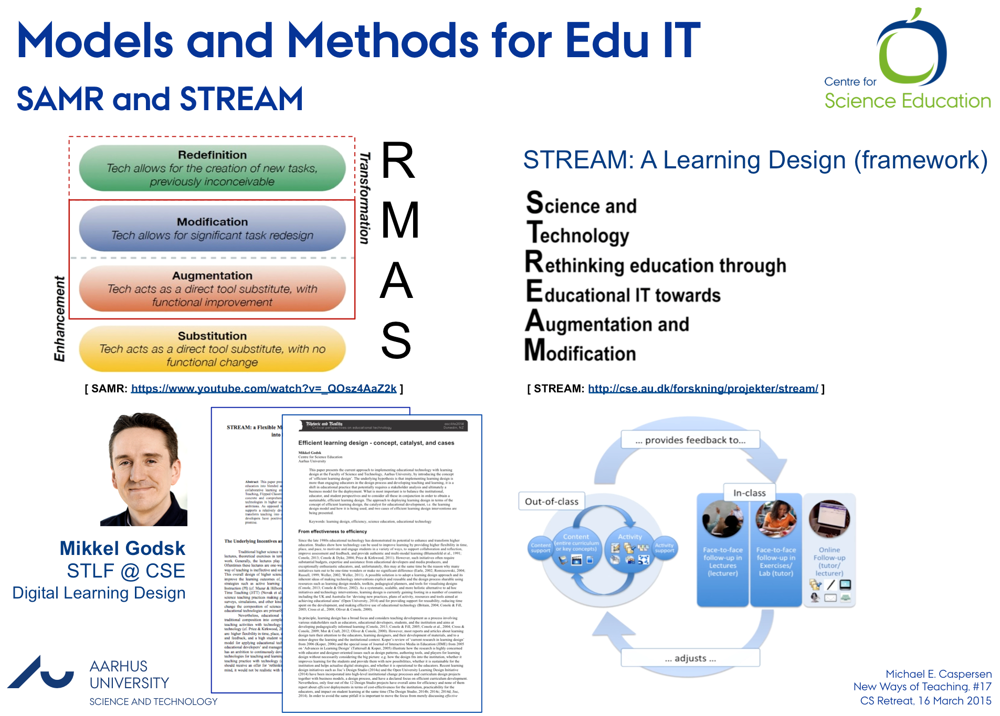
Summary: New Ways of Teaching

Slide 24
New Ways of Teaching
From naïve to smart use of technology
Michael E. Caspersen
Department of Computer Science
and Centre for Science Education

Slide 25
Agenda
New Ways of Teaching @ ST
  Step 1: Review of Education
  Step 2: Strategies, action plans, ...

Slide 26
Review of Education @ ST
An honest self evaluation
Spring 2015
  Take the ”pulse” of teaching at our bachelor and master degrees aiming for systematic and persistent educational development
Fall 1205-...
  Strategy, action plans, and concrete initiatives to strengthen student learning
Science Education 2025
  Vision and strategy for future education @ ST
Uddannelser
på ST
Intern
rapport
2015
Forberedelse
Survey
Selvundersøgelse
Besøgsrunde
Afrapportering
Præsentation for
fakultetsledelsen
Start-workshop med
uddannelsesansvarlige
Slut-workshop med
uddannelsesansvarlige
Præsentation for
fakultetsledelsen
Januar
Februar
Marts
April
Maj
Juni

Slide 27
Survey
Two Parts: Macro and Micro Perspective
Seven areas
  Constructive alignment: Does teaching forms match learning goals and assessment)?
  Student alignment: Are the student prepared for full profit of activities (e.g. group work, projects, etc.)?
  Coherence: How is coherence among components of a degree ensured?
  Explicit development initiatives: Are there specific initiatives in place for development of teaching and teaching skills?
  Challenges: What are the educational challenges at the department?
  Pedagogical training: Which training programs are initiated for teachers in the department?
  Teaching-themed activities: Which activities are implemented with (partly) themed around teaching?
Macro (‘uddannelsesansvarlig’): Primarily free response questions
  More thorough and more time consuming
Micro (‘kursusansvarlig’): Primarily MCQ/Likert-scale
  Simple to answer
  Anonymous – only interested in aggregated data

Slide 28
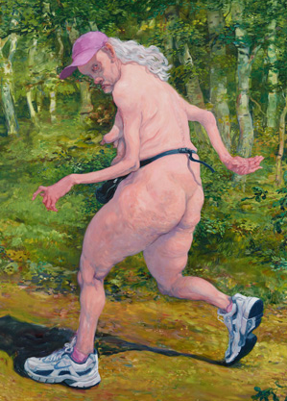

Some Remarks
Ensuring optimal outcome
Quality assurance
  Review of questionnaires by a few departments (‘uddannelsesansvarlige’)
Not a model competition
  No benchmarking, no “grading”!
  We are aiming for an honest self-evaluation
  We want to provide the best possible groundwork for systematic and persistent modernization of teaching and educations
CSE
  Design of process and survey
  Analysis of self-evaluations to identify common denominators (introductory chapter in the final report)

